Slide 1
Arduino IDE and installation
The Arduino software (IDE) is open-source software. We are required to write the code and upload the code to the board to perform some tasks. The Arduino IDE software can be used with any type of Arduino boards. The software is available for various operating system such as, Windows, Linux, and Mac OS X. It supports the programming languages C and C++. Here, IDE stands for Integrated Development Environment.
The program or code written in the Arduino IDE is often called as sketching. We need to connect
the Genuino and Arduino board with the IDE to upload the sketch written in the Arduino IDE software. The sketch is saved with the extension '.ino.'

Slide 2
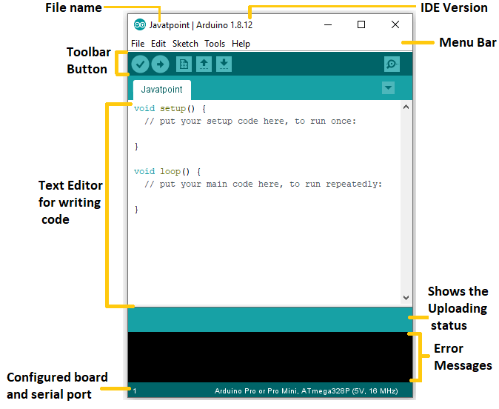
The Arduino IDE will appear as:

Slide 3
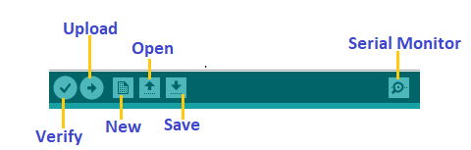
Let's discuss each section of the Arduino IDE display in detail.
Toolbar Button. The icons displayed on the toolbar are New, Open, Save, Upload, and Verify. It is shown below:
Upload. The Upload button compiles and runs our code written on the screen. It further uploads the code to the connected board. Before uploading the sketch, we need to make sure that the correct board and ports are selected.
We also need a USB connection to connect the board and the computer. Once all the above measures are done, click on the Upload button present on the toolbar.

Slide 4

The latest Arduino boards can be reset automatically before beginning with Upload. In the older
boards, we need to press the Reset button present on it. As soon as the uploading is done successfully, we can notice the blink of the Tx and Rx LED.
If the uploading is failed, it will display the message in the error window.
We do not require any additional hardware to upload our sketch using the Arduino Bootloader.
A Bootloader is defined as a small program, which is loaded in the microcontroller present on the board. The LED will blink on PIN 13.
Open. The Open button is used to open the already created file. The selected file will be opened in the current window.
Save. The save button is used to save the current sketch or code.
New. It is used to create a new sketch or opens a new window.
Verify. The Verify button is used to check the compilation error of the sketch or the written code.
Serial Monitor. The serial monitor button is present on the right corner of the toolbar. It opens the serial monitor. It is shown below:

Slide 5
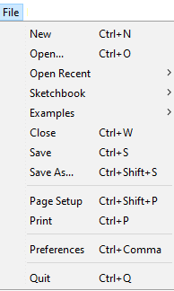
When we connect the serial monitor, the board will reset on the operating system Windows, Linux, and Mac OS X. If we want to process the control characters in our sketch, we need to use an external terminal program. The terminal program should be connected to the COM port, which will be assigned when we connect the board to the computer.
Menu Bar
File
When we click on the File button on the Menu bar, a drop-down list will appear. It is shown below:

Slide 6
Let's discuss each option in detail.
New. The New button opens the new window. It does not remove the sketch which is already present.
Open. It allows opening the sketch, which can be browsed from the folders and computer drivers.
Open Recent. The Open Recent button contains the list of the recent sketches.
Sketchbook. It stores the current sketches created in the Arduino IDE software. It opens the selected sketch or code in a new editor at an instance.
Examples. It shows the different examples of small projects for a better understanding of the
IDE and the board. The IDE provides examples of self-practice.
Close. The Close button closes the window from which the button is clicked.
Save. The save button is used to save the current sketch. It also saves the changes made to the current sketch. If we have not specified the name of the file, it will open the 'Save As...' window.
Save As... We can save the sketch with a different name using the 'Save As...' button. We can also change the name accordingly.

Slide 7
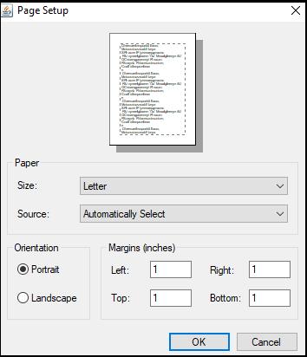
Page Setup. It allows setting the page margins, orientation, and size for printing. The 'Page Setup' window will appear as:
Print. According to the settings specified in the 'Page Setup', it prepares the current sketch for printing.
Preferences. It allows the customization settings of the Arduino IDE.
Quit. The Quit button is used to close all the IDE windows. The same closed sketch will be reopened when we will open the Arduino IDE.

Slide 8
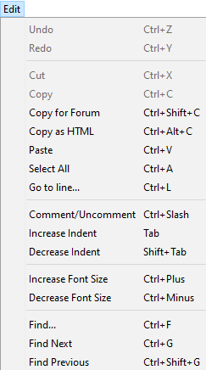
Edit
When we click on the Edit button on the Menu bar, a drop-down list appears. It is shown below:

Slide 9
Let's discuss each option in detail.
Undo. The Undo button is used to reverse the last modification done to the sketch while editing.
Redo. The Redo button is used to repeat the last modification done to the sketch while editing. Cut. It allows us to remove the selected text from the written code. The text is further placed to the clipboard. We can also paste that text anywhere in our sketch.
Copy. It creates a duplicate copy of the selected text. The text is further placed on the clipboard.
Copy for Forum. The 'Copy for Forum' button is used to copy the selected text to the clipboard, which is also suitable for posting to the forum.
Copy as HTML. The 'Copy for Forum' button is used to copy the selected text as HTML to the clipboard. It is desirable for embedding in web pages.
Paste. The Paste button is used to paste the selected text of the clipboard to the specified position of the cursor.
Select All. It selects all the text of the sketch.

Slide 10
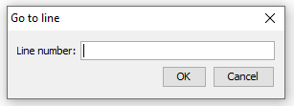
Go to line... It moves the cursor to the specified line number. The window will appear as:
Comment/Decomment. The Comment/ Decomment button is used to put or remove the comment mark (//) at the beginning of the specified line.
Increase Indent. It is used to add the space at the starting of the specified line. The spacing moves the text towards the right.
Decrease Indent. It is used to subtract or remove the space at the starting of the specified line. The spacing moves the text towards the left.
Increase Font Size. It increases the font size of the written text.
Decrease Font Size. It decreases the font size of the written text.

Slide 11
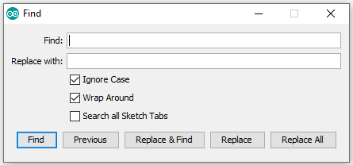
Find... It is used to find the specified text. We can also replace the text. It highlights the text in the sketch. The window will appear as:
Find Next. It highlights the next word, which has specified in the 'Find...' window. If there is no such word, it will not show any highlighted text.
Find Previous. It highlights the previous word, which has specified in the 'Find...' window. If there is no such word, it will not show any highlighted text.

Slide 12
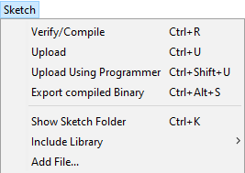
Sketch
When we click on the Sketch button on the Menu bar, a drop-down list appears. It is shown
below:
Let's discuss each option in detail.
Verify/Compile. It will check for the errors in the code while compiling. The memory in the console area is also reported by the IDE.
Upload. The Upload button is used to configure the code to the specified board through the port. Upload Using Programmer. It is used to override the Bootloader that is present on the board. We can utilize the full capacity of the Flash memory using the 'Upload Using Programmer' option. To implement this, we need to restore the Bootloader using the Tools-> Burn Bootloader option to upload it to the USB serial port.

Slide 13
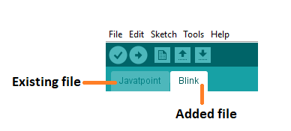
Export compiled Binary. It allows saving a .hex file and can be kept archived. Using other tools, .hex file can also be sent to the board.
Show Sketch Folder. It opens the folder of the current code written or sketch.
Include Library. Include Library includes various Arduino libraries. The libraries are inserted into our code at the beginning of the code starting with the #. We can also import the libraries from .zip file.
Add File... The Add File... button is used to add the created file in a new tab on the existing file. For example, let's add 'Blink' file to the 'Javatpoint' file. The tab will now appear as:
We can also delete the corresponding file from the tab by clicking on the small triangle -
> Delete option.

Slide 14
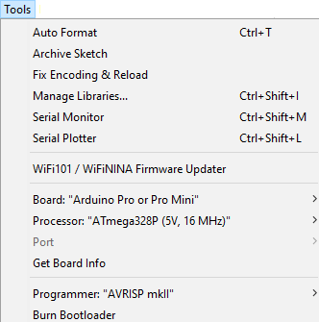
Tools
When we click on the Tools button on the Menu bar, a drop-down list appears. It is shown
below:

Slide 15
Let's discuss each option in detail.
Auto Format. The Auto Format button is used to format the written code. For example, lining the open and closed curly brackets in the code.
Archive Sketch. The copy of the current sketch or code is archived in the .zip format. The directory of the archived is same as the sketch.
Fix Encoding and Reload. This button is used to fix the inconsistency between the operating system char maps and editor char map encoding.
Manage Libraries... It shows the updated list of all the installed libraries. We can also use this option to install a new library into the Arduino IDE.
Serial Monitor. It allows the exchange of data with the connected board on the port.
Serial Plotter. The Serial Plotter button is used to display the serial data in a plot. It comes preinstalled in the Arduino IDE.

Slide 16
WiFi101/WiFiNINA Firmware Updater. It is used to check and update the Wi-Fi Firmware of the connected board.
Board. We are required to select the board from the list of boards. The selected board must be similar to the board connected to the computer.
Processor. It displays the processor according to the selected board. It refreshes every time during the selection of the board.
Port. It consists of the virtual and real serial devices present on our machine.
Get Board Info. It gives the information about the selected board. We need to select the appropriate port before getting information about the board.
Programmer. We need to select the hardware programmer while programming the board. It is required when we are not using the onboard USB serial connection. It is also required during the burning of the Bootloader.
Burn Bootloader. The Bootloader is present on the board onto the microcontroller. The option is
useful when we have purchased the microcontroller without the bootloader. Before burning the bootloader, we need to make sure about the correct selected board and port.

Slide 17
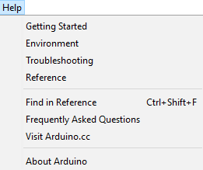
Help
When we click on the Help button on the Menu bar, a drop-down list will appear. It is shown
below:
The Help section includes several documents that are easy to access, which comes along with the Arduino IDE. It consists of the number of options such as Getting Started, Environment, Troubleshooting, Reference, etc. We can also consider the image shown above, which includes all the options under the Help section.
Some documents like Getting started, Reference, etc., can be accessed without the internet connection as well. It will directly link us to the official website of Arduino.

Slide 18
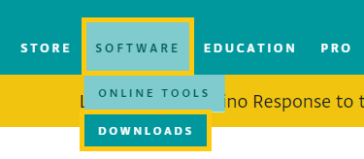
Steps to download Arduino
The steps to download the Arduino software are listed below:
1. Go to the official website of Arduino (https://www.arduino.cc/) > Click on SOFTWARE < click on DOWNLOADS, as shown below:
OR Open the URL https://www.arduino.cc/en/Main/Software

Slide 19
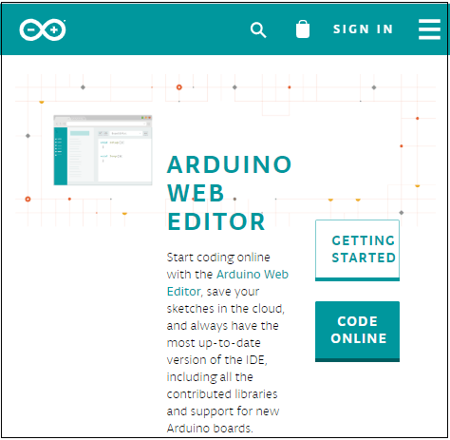
A page will appear, as shown below:

Slide 20
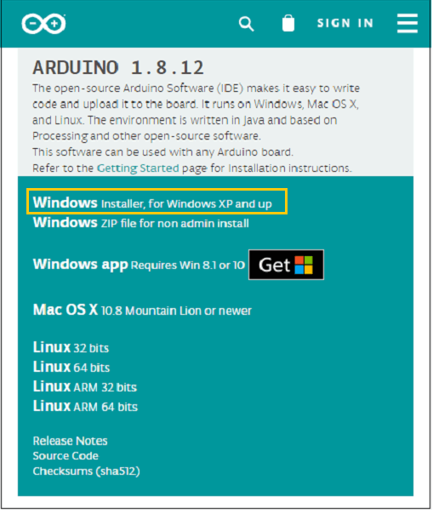
Scroll the screen a little, as shown below:

Slide 21

Click on the 'Windows Installer' as we are operating with the Windows. We can select the Linux or Mac OS X, accordingly.
A contribution window will appear. We can contribute according to our choice and click on the 'CONTRIBUTE & DOWNLOAD' option. Otherwise, click on the 'JUST DOWNLOAD' option, as shown below:

Slide 22

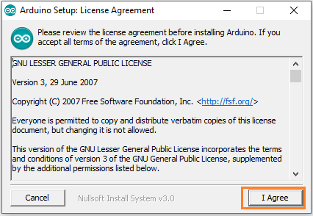
6. The downloading process will start. The downloading file will look like the below image:
Wait for few seconds for the downloading process to complete.
Open the downloaded file.
Grant permission to the Arduino Software on your computer.
Accept the license by clicking on 'I Agree' button as shown below:

Slide 23
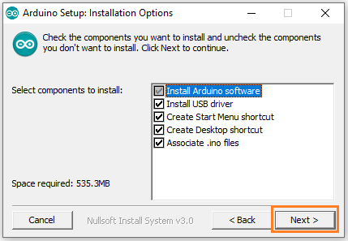
11. Click on the 'Next' button. It is shown below:

Slide 24
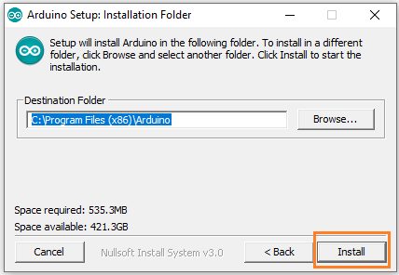
12. The window specifying the location of the installed folder will appear. Click on the 'Install' button. It is shown below:
If you want to change the location, click on the 'Browse' button.

Slide 25
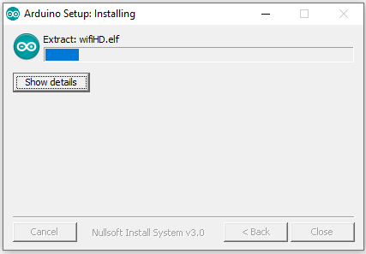
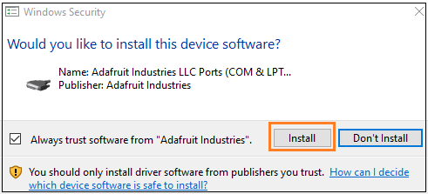
13. The installing process of Arduino will start, as shown below:
Wait for the installation process to complete.
14. Now, we have to accept the security for the installation. We are required to accept the security Installation three times. Click on the 'Install' button. The image is shown below:

Slide 26
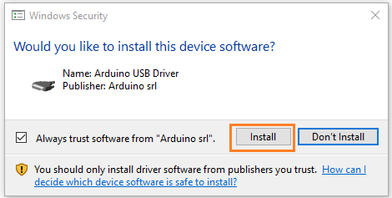

15. Again, click on the 'Install' button. It is shown below:
16. Again, click on the 'Install' button. It is shown below:

Slide 27
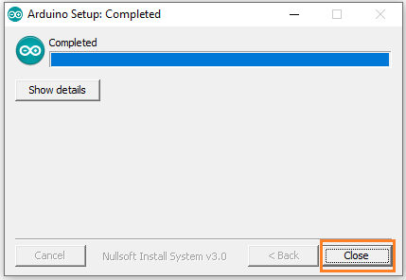

17. The installation process is now completed. The window will now appear as:
18. Click on the 'Close' button at the bottom.
The Arduino IDE software will appear on your desktop, as shown below:

Slide 28
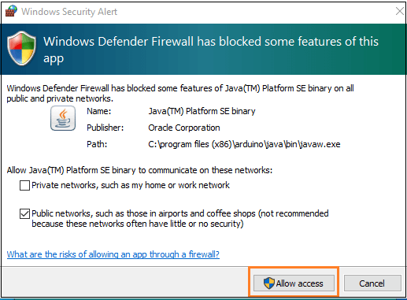
Now, open the Arduino software.
The Arduino IDE environment is written in the programming language named as Java. So, we need to allow access to the Java Platform.
As soon we open the Arduino software, a license window will appear, as shown below:
Accept the license by clicking on the 'Allow access' button.

Slide 29
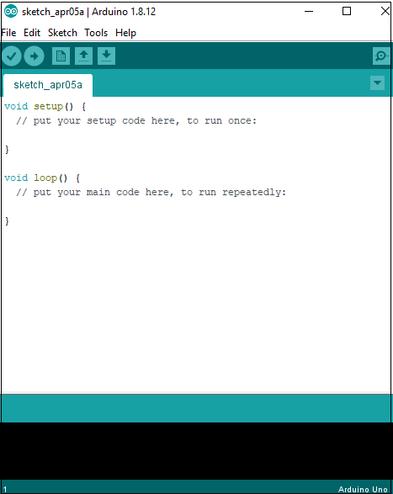
21. The Arduino window will appear as:

Slide 30
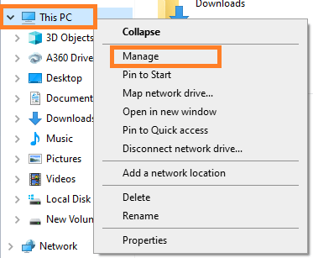
Visibility of the connected Hardware port
We can view the port of the attached hardware Arduino IDE to our computer.
The steps are listed below:
1. Go to the File Manager and right-click on the This PC option, as shown below:

Slide 31
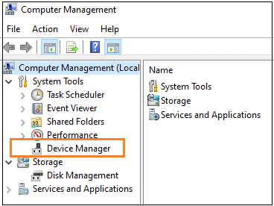
Click on the Manage.
First, we need to connect the Arduino board to our computer.
A window will appear, as shown below:
5. Click on the Device Manager.
Under the PORT option, we can see the ports of the connected hardware.

